Slide 1
YoY Skip Rate Increase Mitigation
Tovala Senior Business Analyst Take-Home

Slide 2
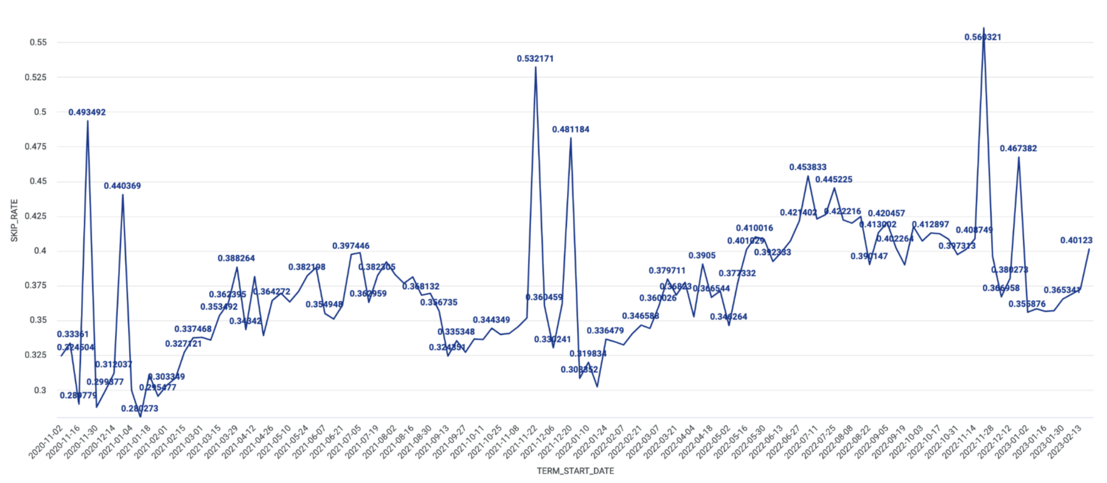
Current Skip Rate (Q4 2020 and Q1 2023)

Slide 3
Data Vantage Point and Data Collection
Including Pandemic data as baseline, which I would be cautious with as this can cause inflated baseline for YoY readings
For skips on food orders, would be nice to collect other data relating to delivery time and product quality upon delivery
Also, would be nice to get data on oven durability
Getting access to customer support team’s top 10 topics addressed would be good start
Took out outliers during holiday season to not look at skewed numbers
Did implement pandemic and holiday flag into data to capture data points that were near holidays/significant eating habit change (New Year’s resolution)

Slide 4
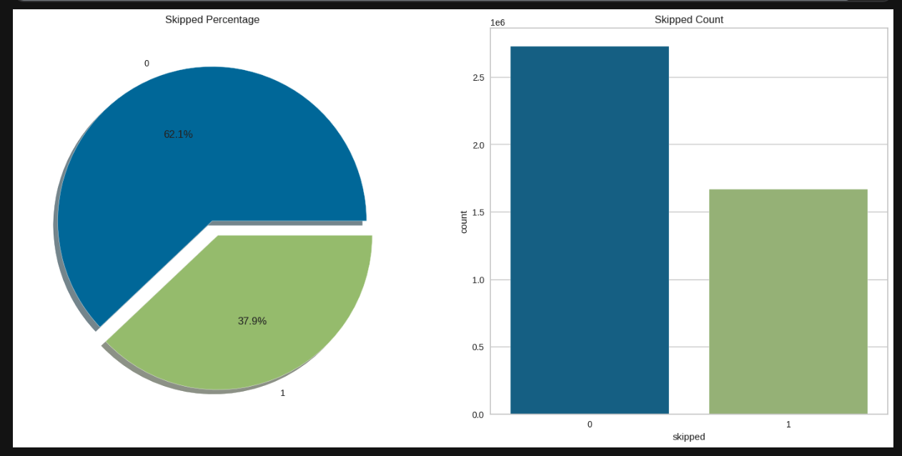
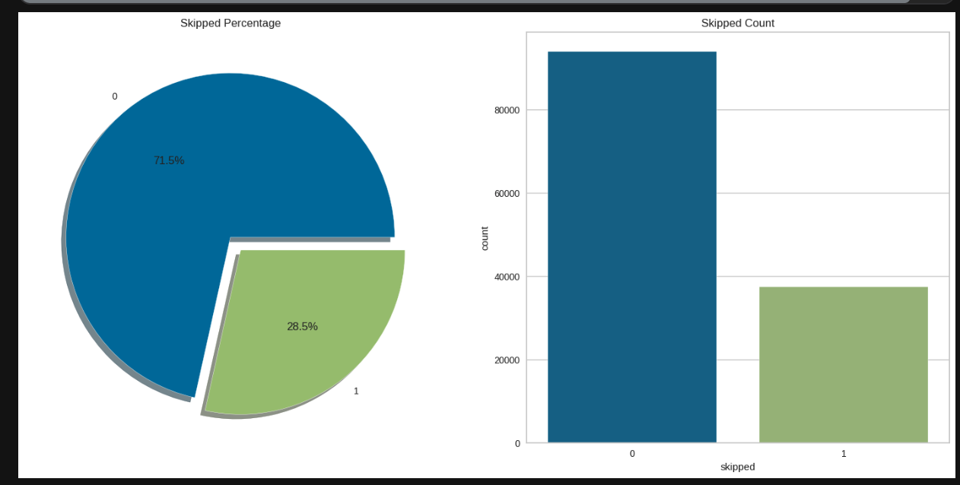
Current Situation
Looking at active subscribers only. At order level, we have around 40% skipped orders. At customer level, we have around 30% of skipped.

Slide 5
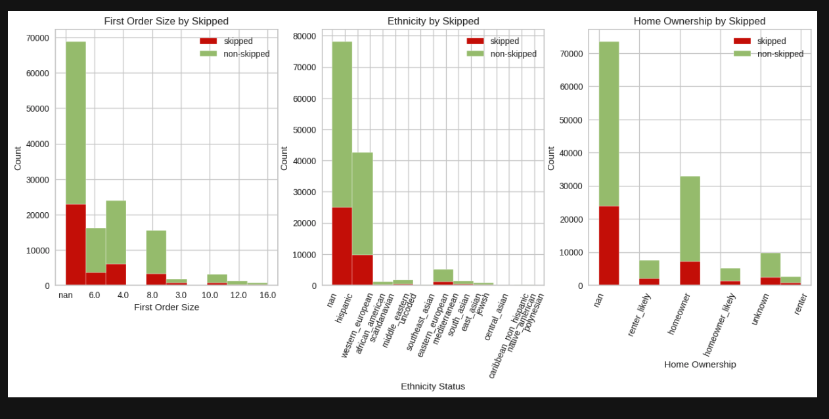
Possible Root Causes
Possibly due to first order size/home ownership, but hard to tell due to amount of customer facts missing from active customers (nan bar).

Slide 6
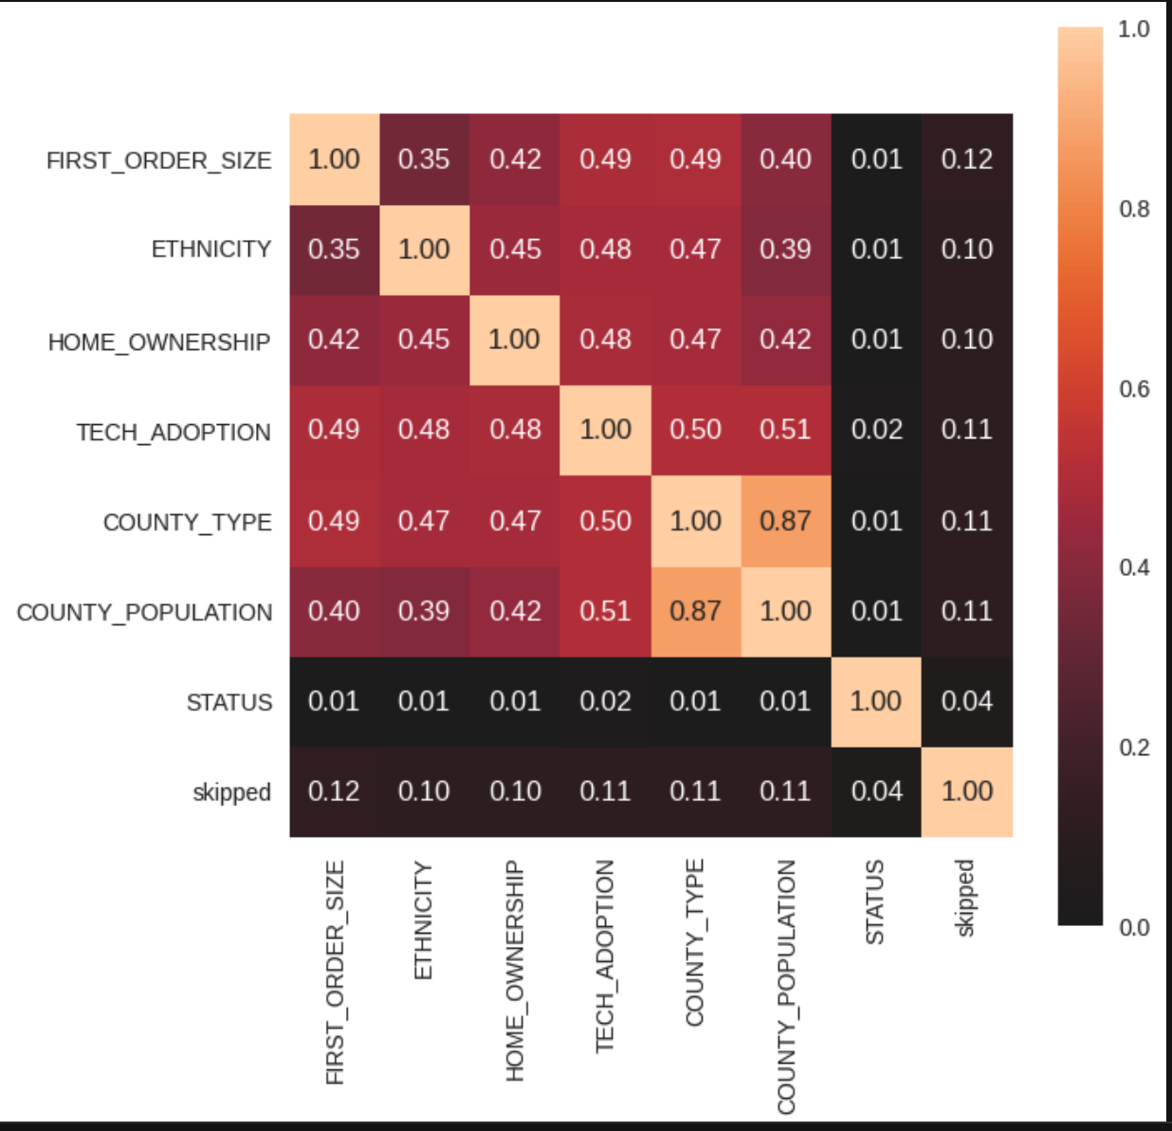
Possible Indicator
However, first order size does seem to have somewhat of a role in whether or not someone will skip in their following order since 0.1 is moderate threshold for significant correlation to skipped.

Slide 7
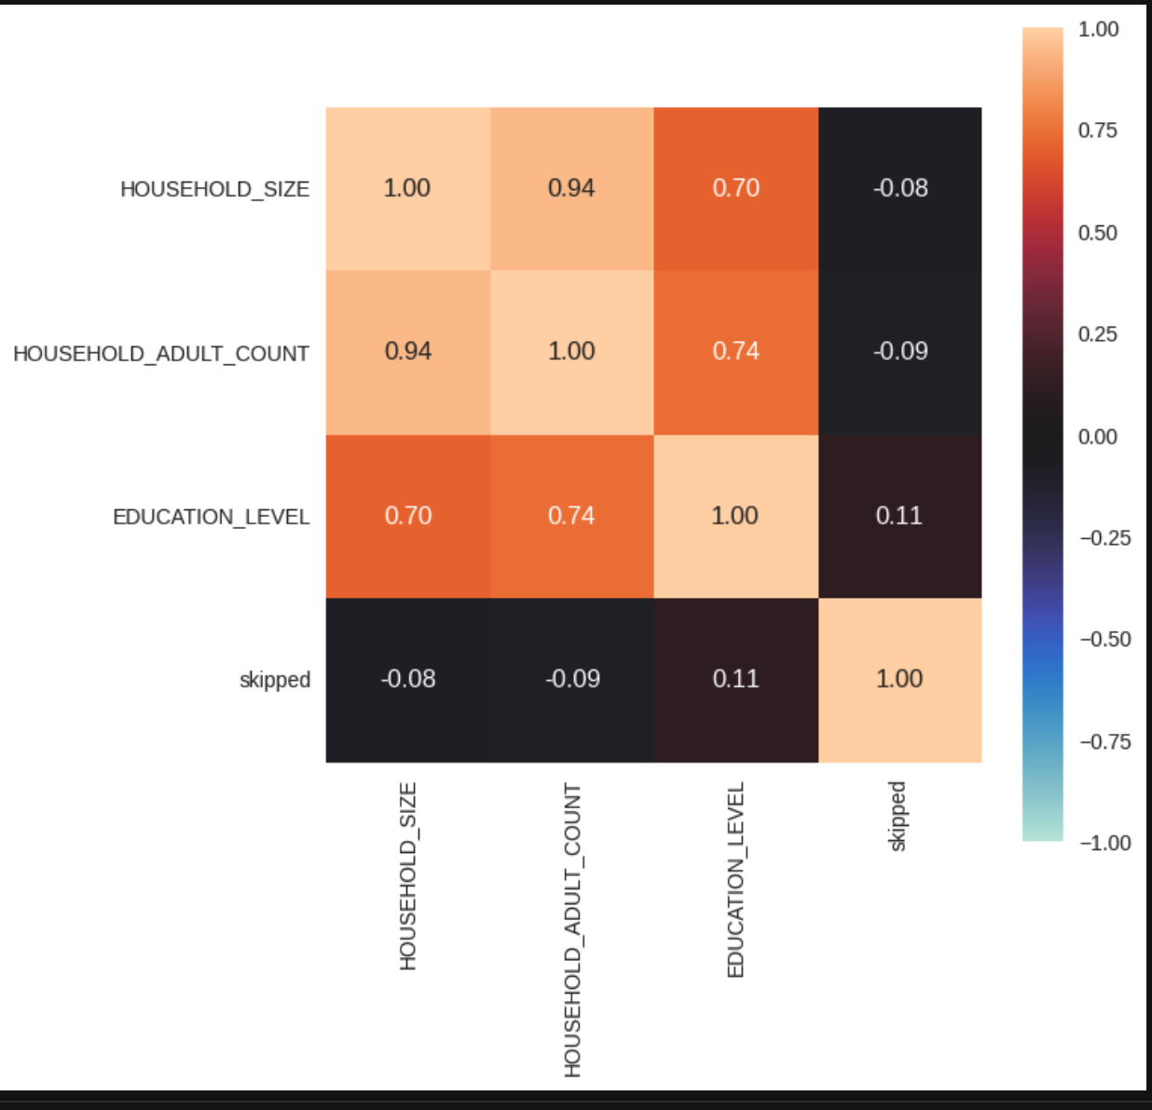
Other Indicators?
Here, we see that education level has somewhat of an influence since 0.1 is moderate association between customer fact and skip.

Slide 8
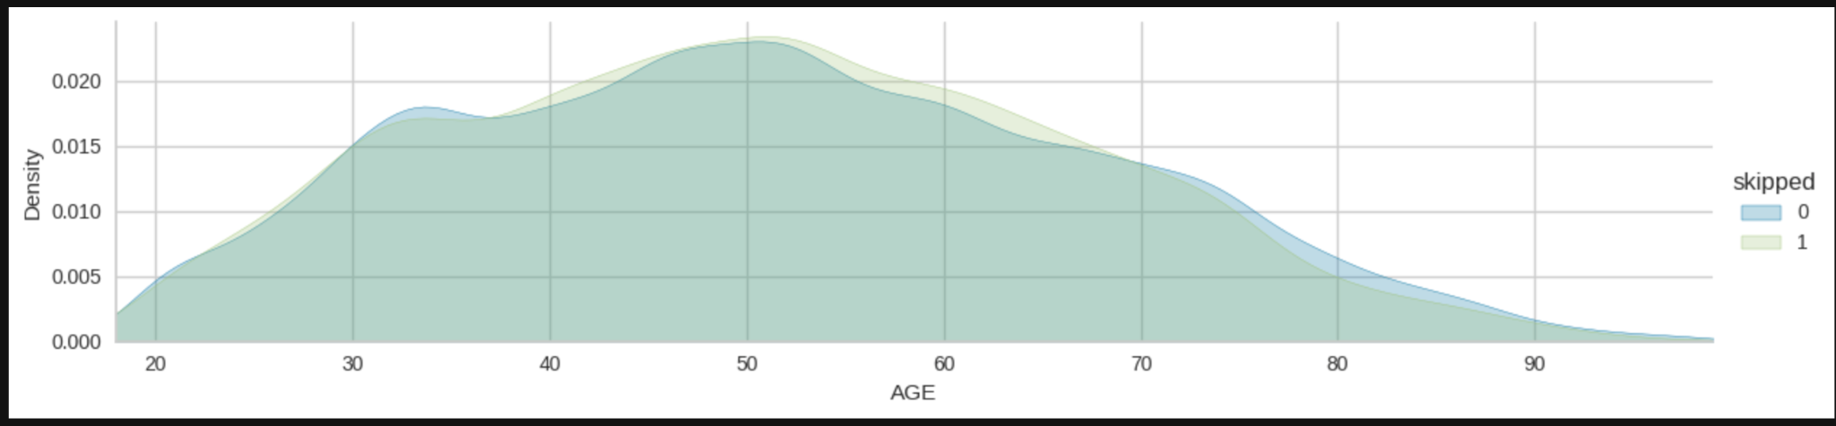
Maybe Age…
Overlap is quite strong. We see here that skipped are usually not at the extreme age groups.

Slide 9
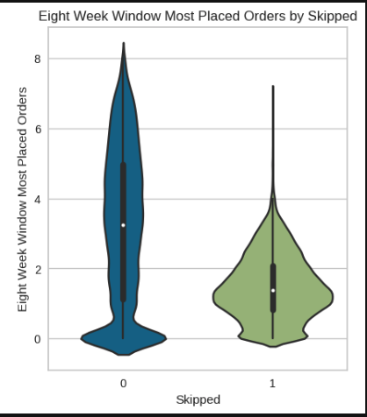
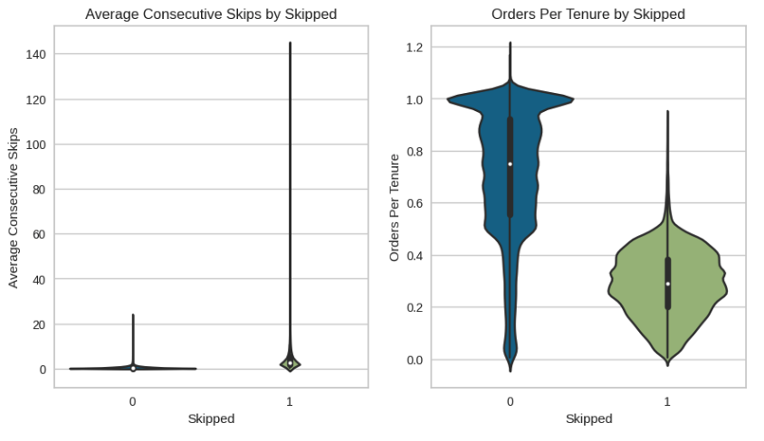
This could be it…
We are starting to see some differences in skipped vs. non-skipped with less orders in 8 week time frame, more consecutive skips and less orders per tenure with skipped.

Slide 10
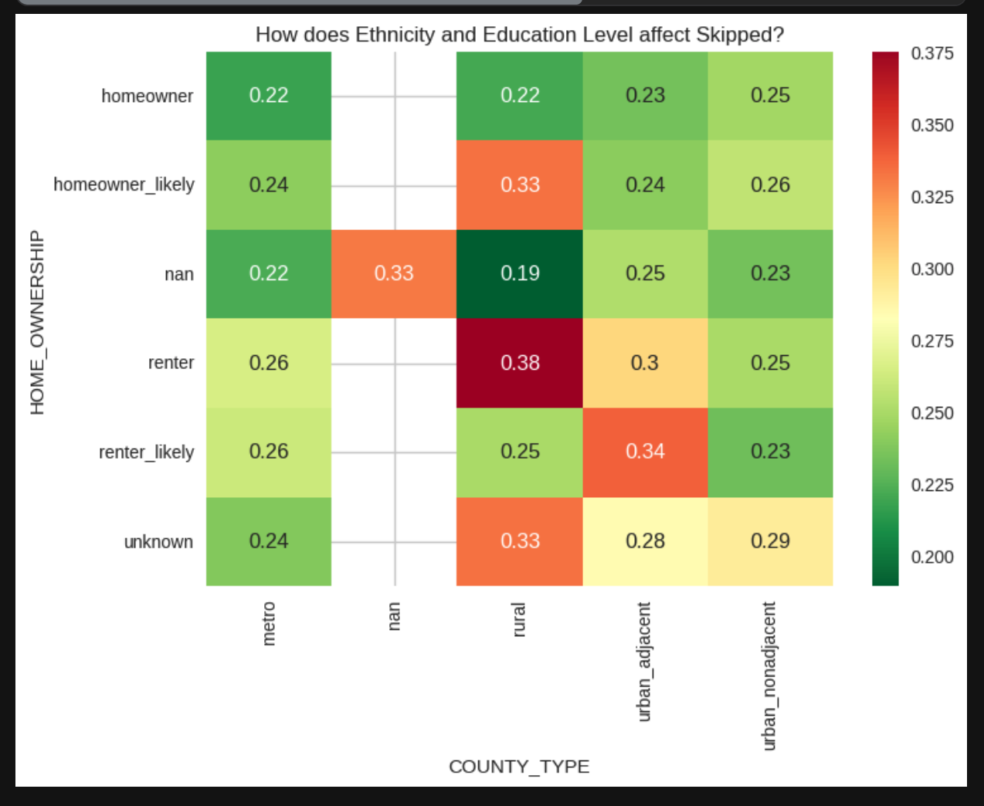
Getting warmer…
When looking at Home Ownership and County Type affecting skipped, there was an indicator that customers in rural areas skipped regardless of homeownership status.

Slide 11
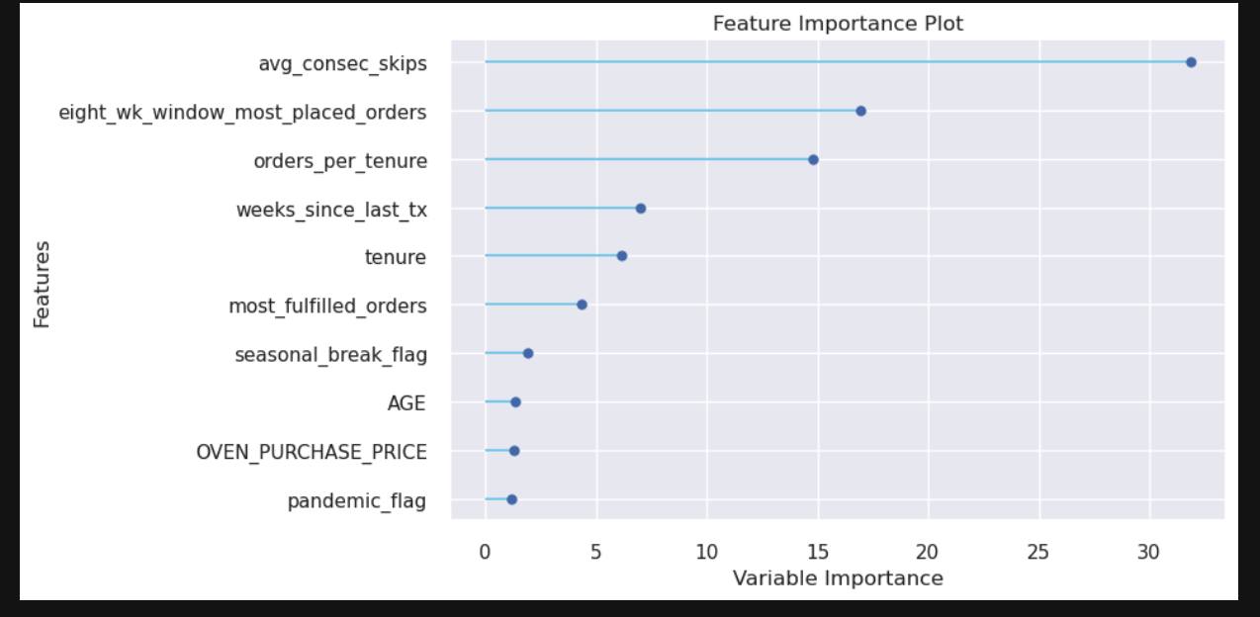
Root Cause/Smoking Gun :)

Slide 12
Data-Backed Recommendations for Business #1
Keep main group of subscribers happy (since they provide the profit) by focusing on their feedback and implementing their advice so they can extend their subscriptions and increase virality of product. This would help with churn since skipped is an indicator of paused/canceled subscriptions. And we rather not have customers churn since it is more expensive to gain a customer than to keep them.
Looks like typical active Tovala customer is western European, homeowner, tech savvy, works in a huge city, female, married, not many in family, into healthy eating, not thrifty, grocery delivery users and foodies, mostly in their 30-50's.

Slide 13
Data-Backed Recommendations for Business #2
I would use above data to define active subscription cohort and target them by offering a loyalty/VIP program to build trust in brand and longevity with Tovala that would provide insight into deals, first offerings of new products coming down the pipe or even ability to craft their own menu with a Tovala chef and see it go live on an Instagram broadcast in real time to build social presence and stickiness to the brand. Effectiveness of loyalty program would be determined by conducting an A/B test.
For those that are skipping, I would look into the customer support desk data and look at the top most common issues, such as delivery quality and address them quickly (especially for brand new Tovala users since they have a short window of time to impress). Switch third party vendors for delivery and if an oven is not meeting SLA then immediately send a replacement because with new companies, reputation is still being built. So quickly remedying issues is key for business' success.

Slide 14
Data-Backed Recommendations for Business #3
Last, but not least: really monitor orders per tenure, consecutive skips closely to alarm Tovala customer success team if users are likely to churn or not and actively re-engage them by giving freebies/vouchers, meal/oven discounts to keep them engaged.
Would set up threshold for alarm by looking at historical data on active subscribers who skipped and eventually churned and get average reads from them to determine threshold for alarm.

